Slide 1
MAY15-30:
Fast, Compact, High Strength Magnetic Pulse Generator

Slide 2





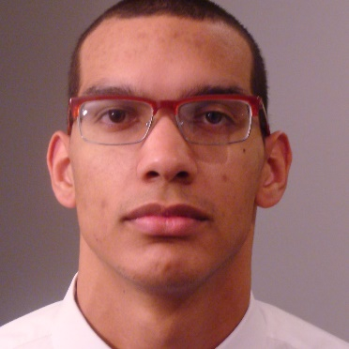

Team Members
Adam Kaas
Leader
Meiyong Himmtann
Webmaster
Greg Fontana
Simulator
Brittany Duffy
Communication Leader
Alain Ndoutoume
Systems Leader & Commissioner
Brandon Dixon
Layout Designer
Megan Sharp
Coil Designer
Advisors
Dr. Mani Mina, Senior Lecturer
Dr. John Pritchard, Graduate Student
Client
Iowa State University High Speed Systems Engineering Lab
May15-30: Fast, Compact, High Strength Magnetic Pulse Generator

Slide 3
Presentation Outline
Project Scope
Design Cycle
  Coils
  Schematics
  Layouts
Test Plan
  Electronics Test Plan
  Optics Test Plan
Results
Challenges
May15-30: Fast, Compact, High Strength Magnetic Pulse Generator
Notes:
Who is the client? HSSE, Dr. Mani Mina and Dr. John Pritchard
Why does the client think it is important? Our client has a need for a small-scale, low-power high strength magnetic field driver to use with his interferometer experiment.

Slide 4
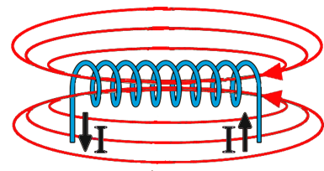
Project Scope
Deliverables
  Fast (1µs)
  Compact (3.5” x2”)
  High Strength (500 G)
Current driven through a coil will generate a magnetic field
May15-30: Fast, Compact, High Strength Magnetic Pulse Generator

Slide 5
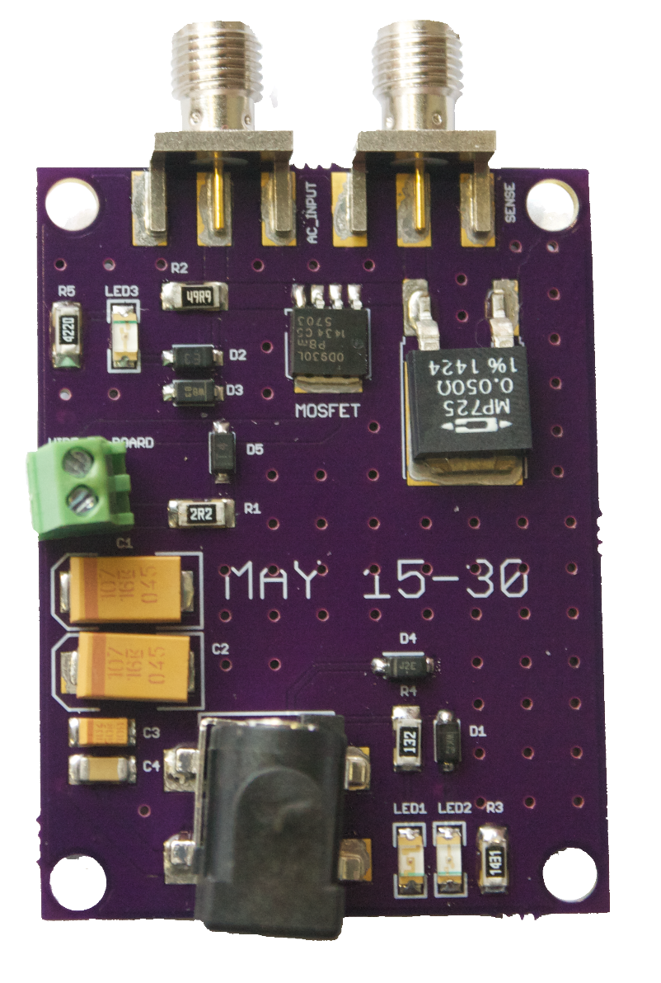
Project Scope
Functions
  Generates a magnetic field with strength ≥ 500 gauss
  Able to generate a magnetic field using a 1µs pulse width
Features
  Barrel jack for ≤ 15 V DC source
  SMA port for pulse generator
  SMA port for 0.050 Ω current sense resistor
  Wire to board connection allows for interchangeable coils
  Indicator LEDs for user friendly functions and protective circuitry
  Dimensions: 3.5" x 2”
May15-30: Fast, Compact, High Strength Magnetic Pulse Generator

Slide 6
Design Cycle
Consider Design Specs
  -Define coil team
  -Define MOSFET/ circuit team
Choose Coil
-Aim for low inductance
-Aim for high field
Test PCB
-Determine PCB meets all criteria
Choose MOSFET
-Handle design specs
-Handle current passing through coil
Solder Components onto PCB
Create PCB
-Protomat/ OSHPark
Optimize Circuit
-Optimize circuit components around chosen MOSFET and coil
-Rearrange components
Create Layout
-Use EAGLE PCB
Simulate
-Aim for appropriate rise and fall times using OrCAD
May15-30: Fast, Compact, High Strength Magnetic Pulse Generator
Notes:
Inductance - rise and fall time
500 gauss - current, # of turns, wire

Slide 7
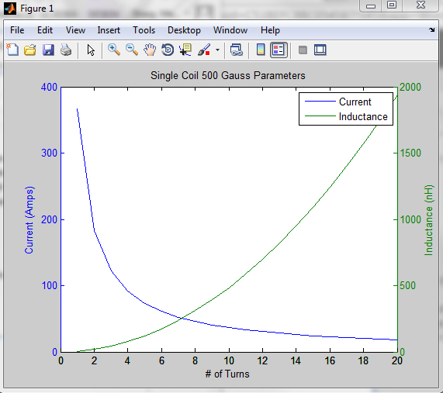
Coils
Lower inductance → faster rise time
  Lower inductance requires higher current to maintain field strength
May15-30: Fast, Compact, High Strength Magnetic Pulse Generator
Notes:
Megan’s changing this image.

Slide 8
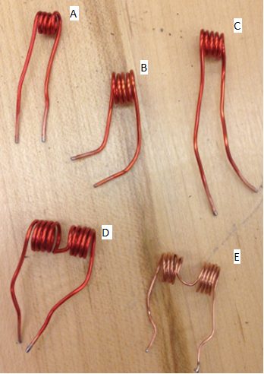
Coils Continued...
Helmholtz coils give a stronger magnetic field for similar parameters
Single coils give lower inductance for similar parameters
May15-30: Fast, Compact, High Strength Magnetic Pulse Generator
Notes:
Megan is changing this to use coil C.

Slide 9
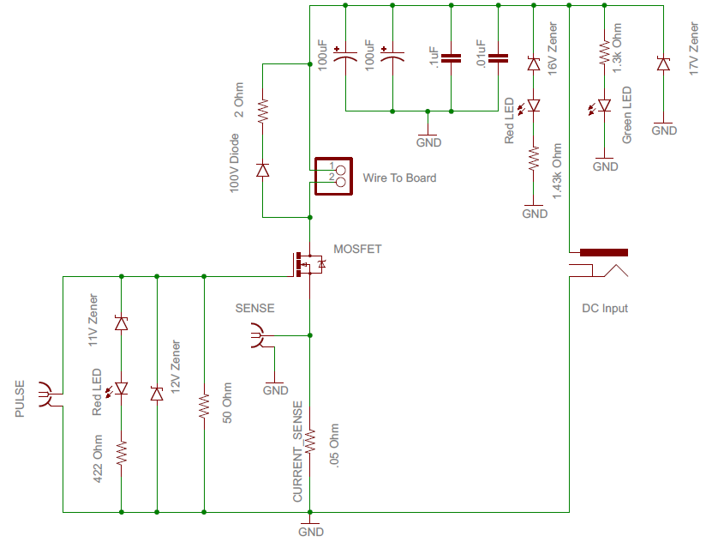
Schematic
May15-30: Fast, Compact, High Strength Magnetic Pulse Generator
Notes:
Make Block diagram of this?
Talk about Pulse Input, Current Sense, MOSFET, Capacitors, DC Input, Wire-To-Board
Darken letters

Slide 10
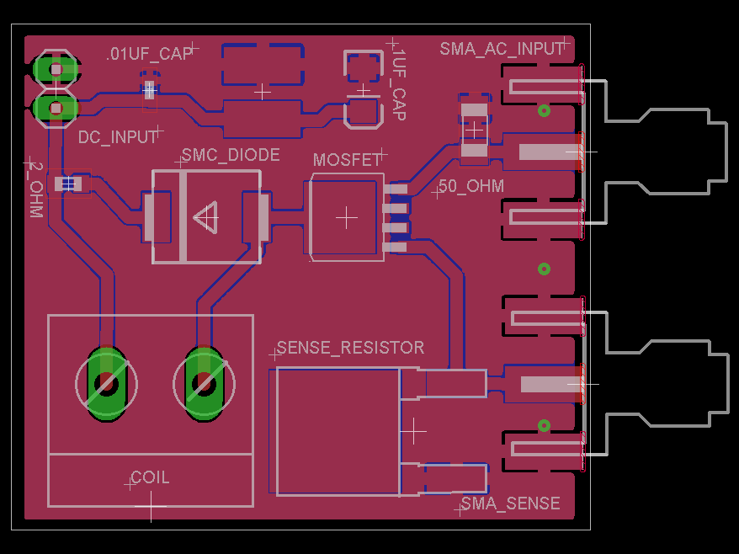
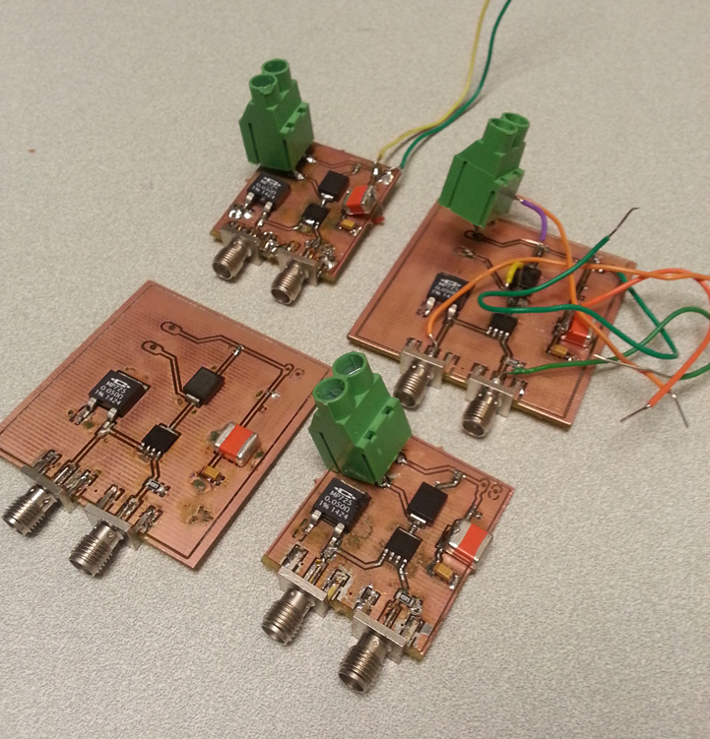
Layout Process Version 1
Designed in EaglePCB
Created on ProtoMat S62
May15-30: Fast, Compact, High Strength Magnetic Pulse Generator
Notes:
This layout utilized the components we selected to achieve the simulation results we originally tested.

Slide 11
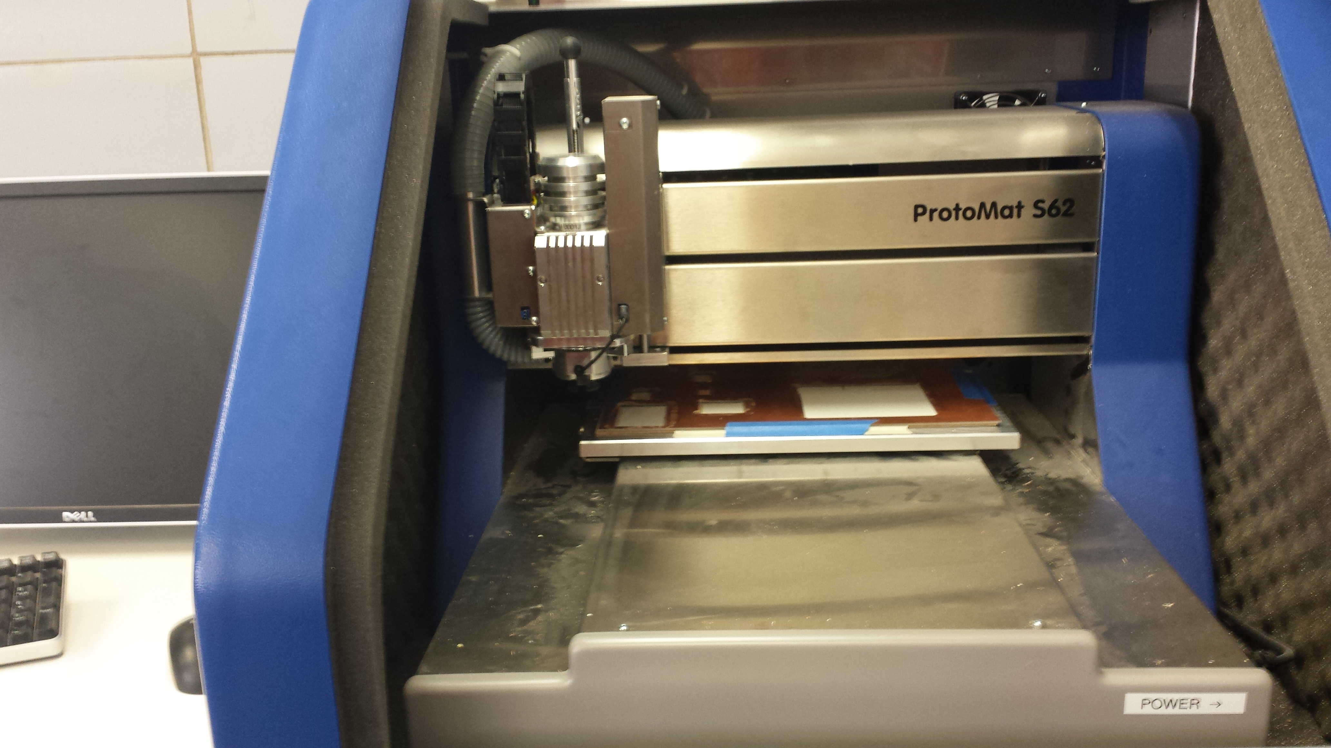
Layout to Protoype
ProtoMat S62
Export Layout in GERBER file
Each file indicates a particular layer
Copper top(GTL) and bottom layer(GBL)
Drill size(TXT)
Create Isolation around the line
May15-30: Fast, Compact, High Strength Magnetic Pulse Generator

Slide 12
Protomat S62
Video Here
May15-30: Fast, Compact, High Strength Magnetic Pulse Generator

Slide 13
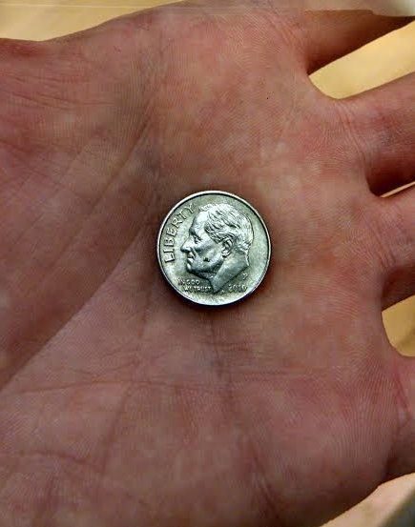
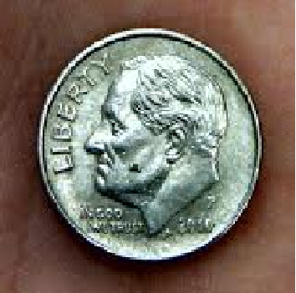
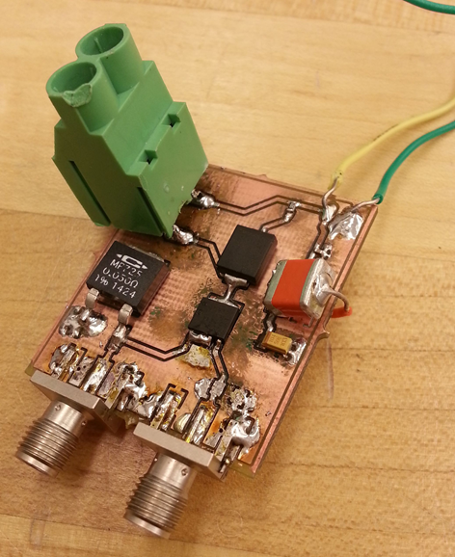
Soldering Challenges
Size of components
Size of board
Weak traces
May15-30: Fast, Compact, High Strength Magnetic Pulse Generator

Slide 14
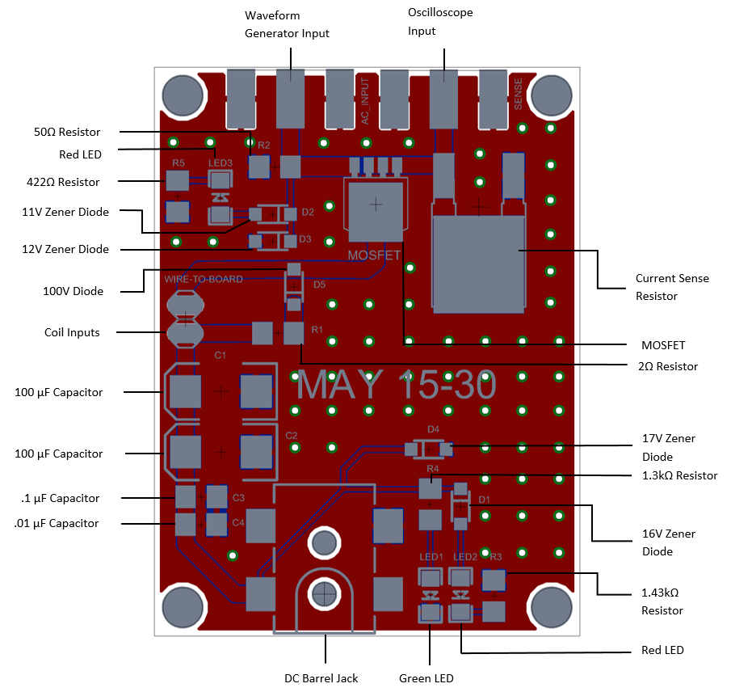
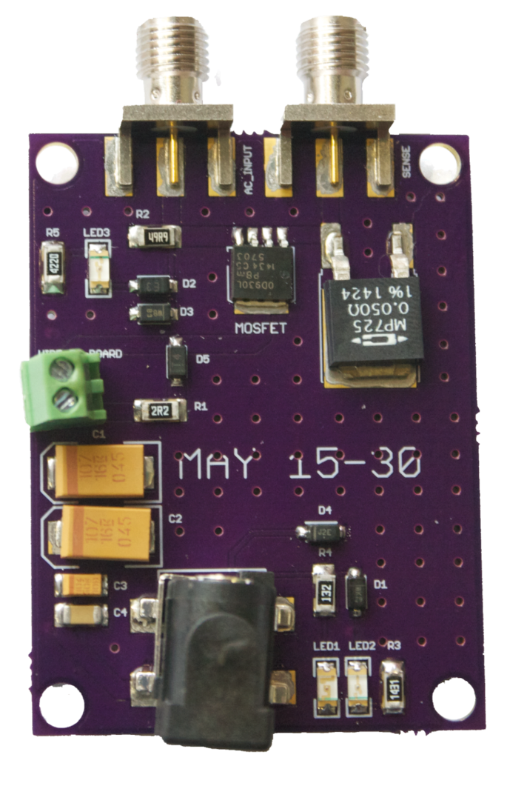
Layout Process Version 2
Designed in EaglePCB
Sent to OSHPark
May15-30: Fast, Compact, High Strength Magnetic Pulse Generator
Notes:
This layout replaced many components with more user-friendly components in terms of soldering as well as using more uniform parts.

Slide 15
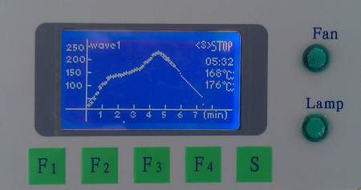
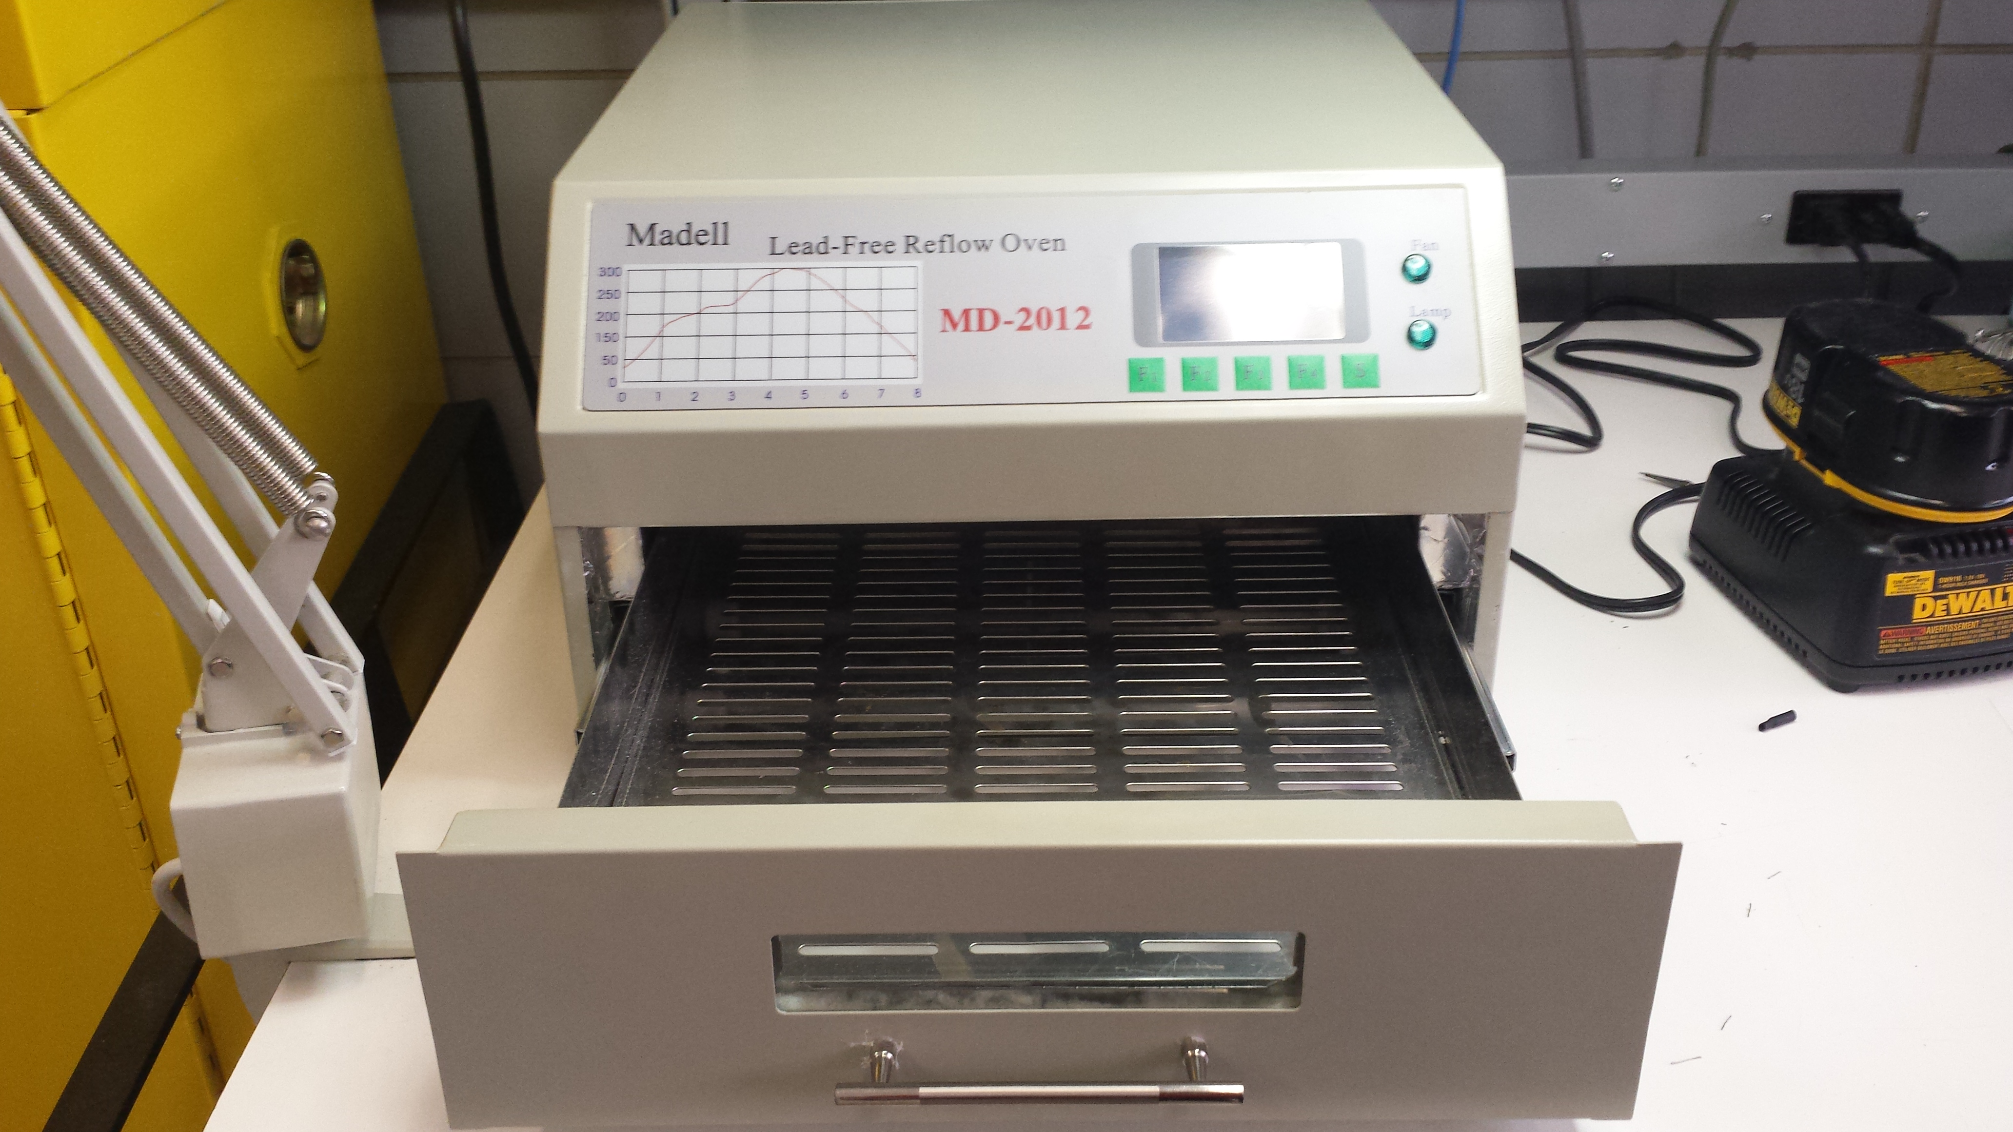
Reflow Soldering
Solder Paste
Reflow Oven
Thermal Profile
Check Connection
May15-30: Fast, Compact, High Strength Magnetic Pulse Generator

Slide 16
Electronics Test Plan
Test Circuit Continuity
Measure Source Voltage
1 µs pulse
Evaluate Current
Magnetic Field strength met?
May15-30: Fast, Compact, High Strength Magnetic Pulse Generator
Notes:
Perform Interferometer Experiment
Using MATLAB
Verify Results

Slide 17
Preliminary Results
15 volts DC input
1 µs pulse width input
2 V amplitude peak-to-peak
Measured pulse width of 930 ns
May15-30: Fast, Compact, High Strength Magnetic Pulse Generator

Slide 18
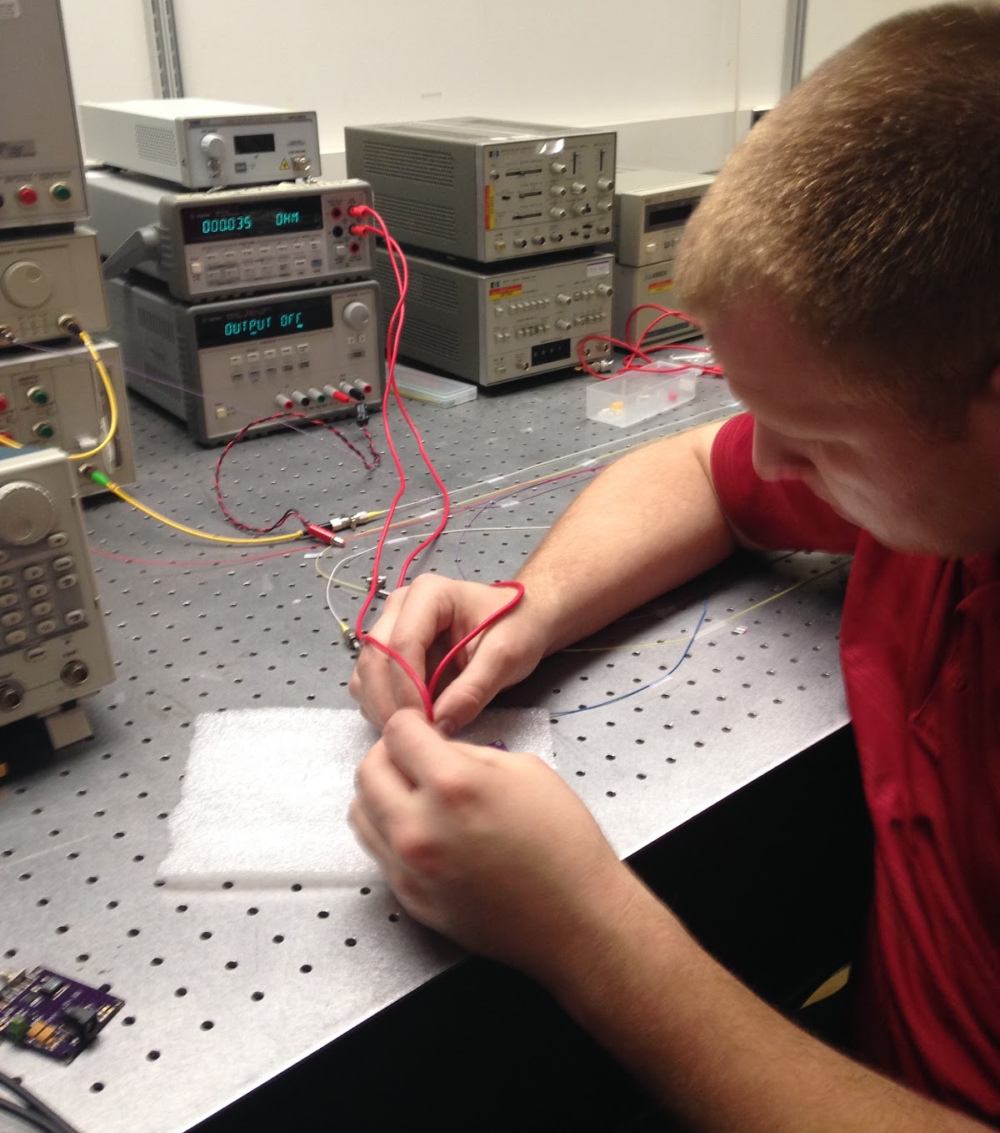
Technical Challenges
Bad Cables
“Cold Solder”
Duty Cycle Considerations
DC Barrel Jack layout incorrect
Measuring magnetic field
May15-30: Fast, Compact, High Strength Magnetic Pulse Generator
Notes:
Throughout our time at Iowa State we are taught to make sure our components aren’t bad by performing tests on them. After we created our board and wanted to perform testing on it, we ran into a lot of troubles. We were constantly checking our components to see if they were bad and we couldn’t find any reason to believe they were. Finally, we removed the SMA connectors from our board and attempted to perform our testing without them. We noticed our board started working and this led us to investigating the cables we had been using. As it turns out, one of our cables was bad and this was why we were held up on testing for several weeks. We replaced the cables and were able to continue on with our testing.
When we performed our continuity checks on our board, we found no issues. One of the challenges with our board is the size of our components. Sometimes, it wasn’t possible to connect the pin to the actual component and you would just connect it to the solder to check for continuity. This is where we ran into another problem on our board with a cold solder issue. Our solution was to jump a wire from the component to the next component after removing the solder.
The DC barrel jack that we use on our new board had a somewhat confusing diagram. As you can see, there are 4 pins that need to be soldered, however 2 of them are the same. We assumed pin 2 was our ground and pin 3 was a pin used for checking if anything is plugged into the DC barrel jack. Unfortunately, we were mistaken. This provided us with another opportunity to understand how these issues can be experienced in the engineering design process. Our solution was to essentially jump a wire from pin 2 to pin 3.

Slide 19
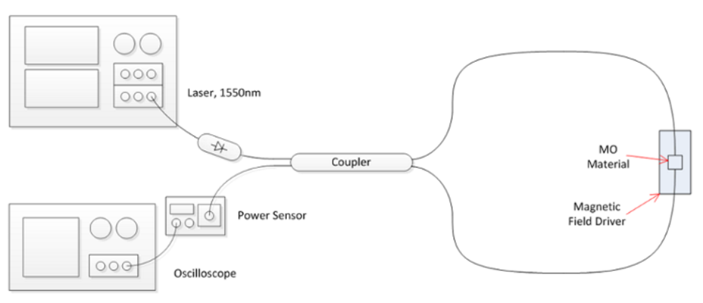
Optics Test Plan
Sagnac Interferometer
Photo Courtesy of Dr. John W. Pritchard
May15-30: Fast, Compact, High Strength Magnetic Pulse Generator
Notes:
Conventional magnetic field detectors are not able to pick up the pulse fast enough because their sample rate is lower than the required 2 MHz we would need. Our client uses a Sagnac Interferometer setup in his lab. This setup is used to detect the magnetic field pulse. The system will send out an optical signal that will split at a coupler and then interfere with itself, resulting in either constructive or destructive interference which will be measured at the output. The interference depends on the state of magnetization of the magneto-optic (MO) material. In one direction, we would measure no output, and when it is magnetized the other way we would see an output.
“How and where does the interference occur?” John
“How does the magnetic field and the material affect the light?” John
Our initial tests were unsuccessful. The single coil with 5 turns we used isn’t generating a strong enough magnetic field to affect the MO material to produce the results necessary.
This is beyond the scope of our project.
4/26***Magnetic field isn’t strong enough- needs to change- MO material did not respond initially.

Slide 20
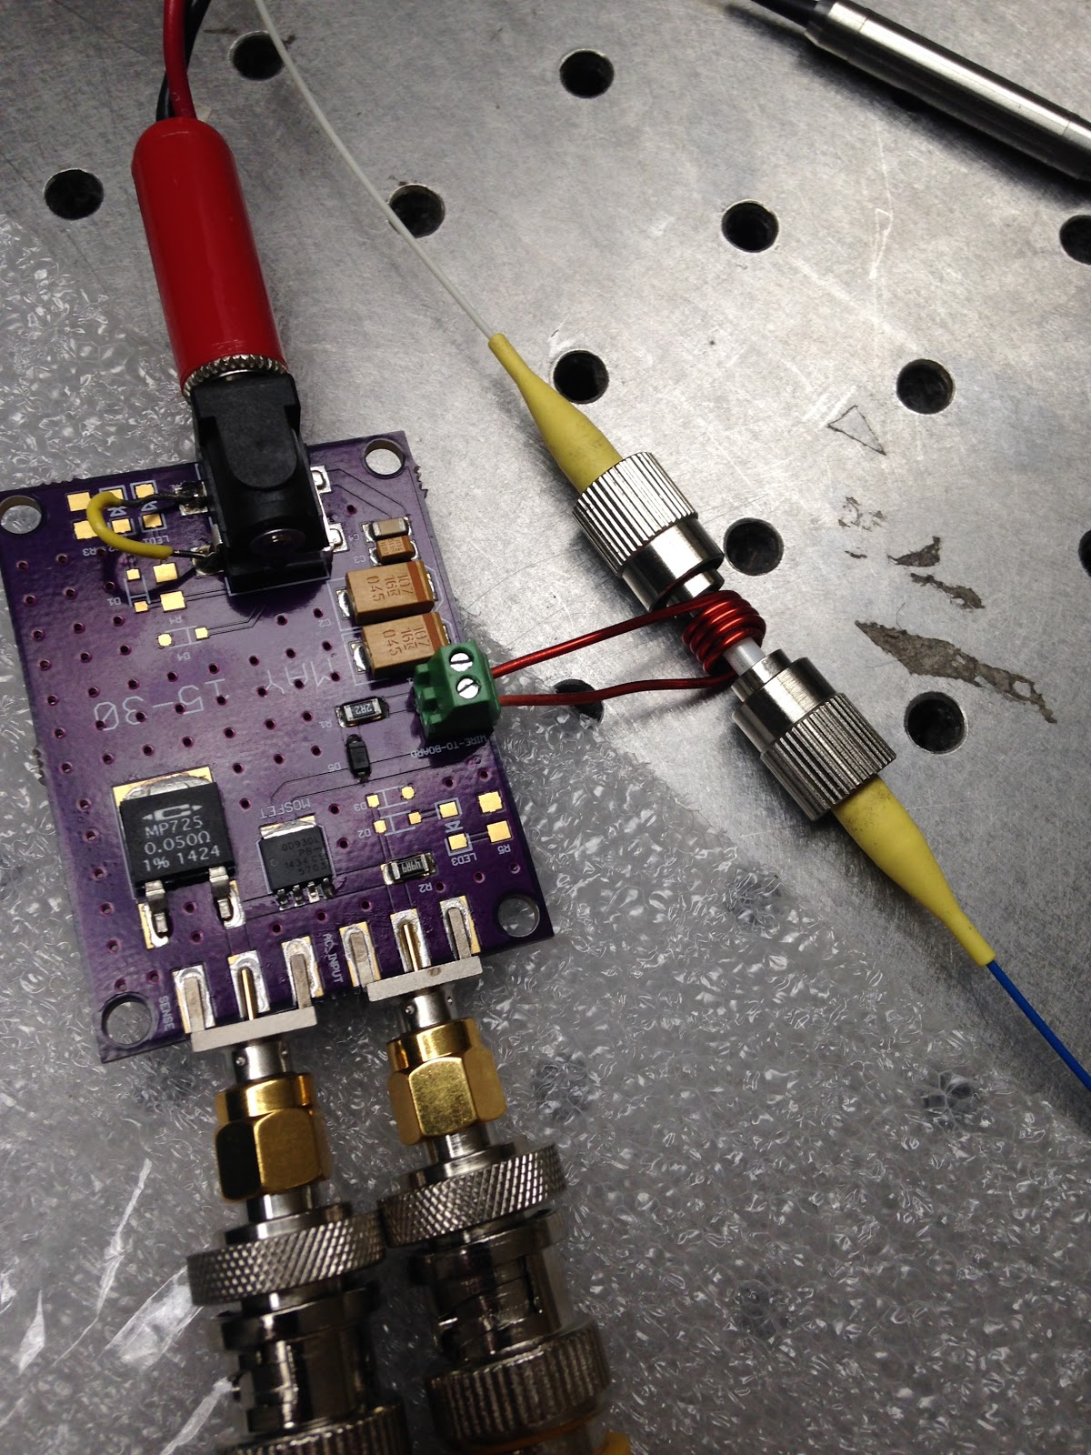
Client’s Experiment
May15-30: Fast, Compact, High Strength Magnetic Pulse Generator
Notes:
Two optical connectors coupled together

Slide 21
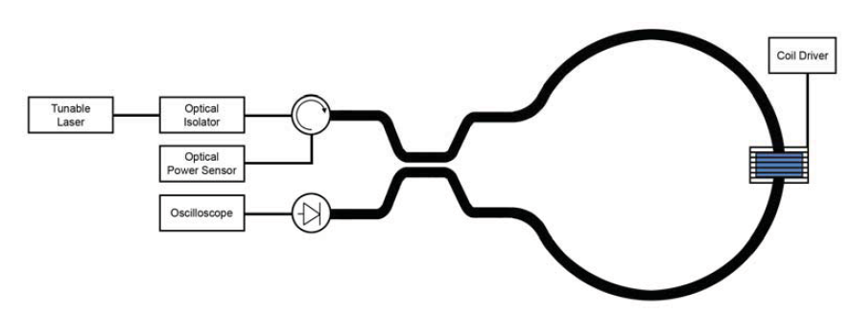
New Test
Transimpedance Amplifier
Tioh, Jin-Wei, "Interferometric switches for transparent networks: development and integration" (2012). Graduate Theses and Dissertations. Paper 12487.
May15-30: Fast, Compact, High Strength Magnetic Pulse Generator
Notes:
Emphasize we scaled it down, add text

Slide 22
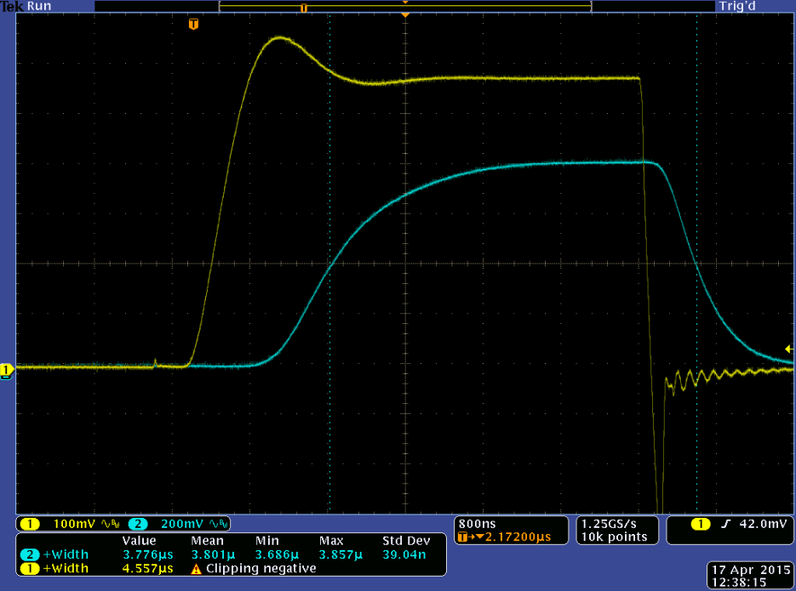
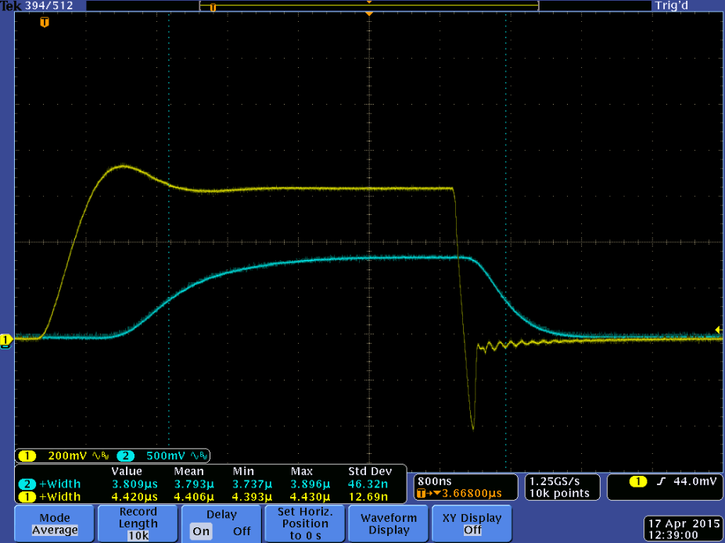
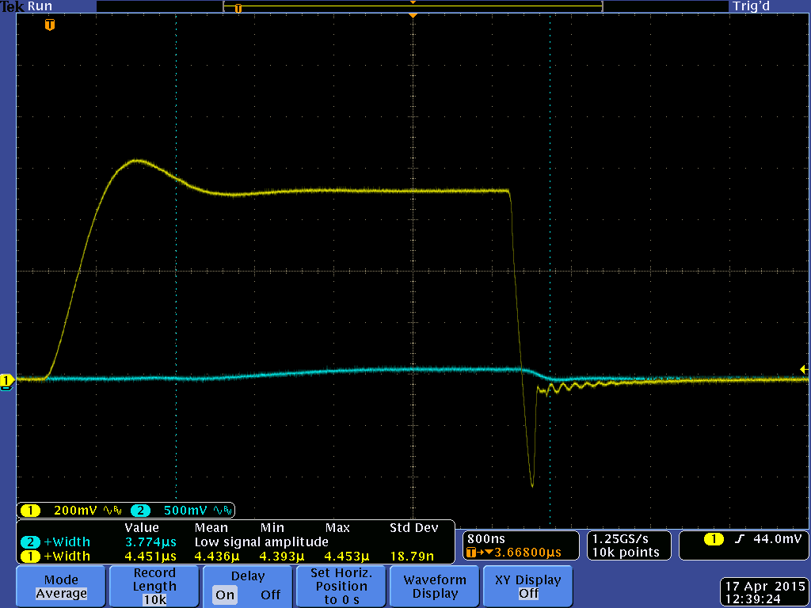
New Test Results
2.8 V Input
2.9 V Input
3.0 V Input
May15-30: Fast, Compact, High Strength Magnetic Pulse Generator

Slide 23
Theoretical Results vs Actual Discrepancy Speculation
Magneto-optic material saturated at 225 G
Current sense resistor voltage ≈ 750 mV
  Current through coil ≈ 15 A
    B ≈ 112 G
Many factors could be responsible
  Magnetic permeability
  Imperfect coil
  Sensitivity of the MO material
  Human error
Ongoing investigation
May15-30: Fast, Compact, High Strength Magnetic Pulse Generator

Slide 24
Conclusion
Achievement of requirements demonstrated to client
Wire-to-board connector allows various coils to be used for other applications such as
  Megawatt Q-switched laser systems
  Research in biomagnetism
  Small solenoid systems
May15-30: Fast, Compact, High Strength Magnetic Pulse Generator
Notes:
Although we didn’t get the theoretical calculations we were expecting, we were able to prove experimentally that our circuit performs how our client expects.

Slide 25

Questions?
Questions?
Questions?
Questions?
May15-30: Fast, Compact, High Strength Magnetic Pulse Generator

Slide 26
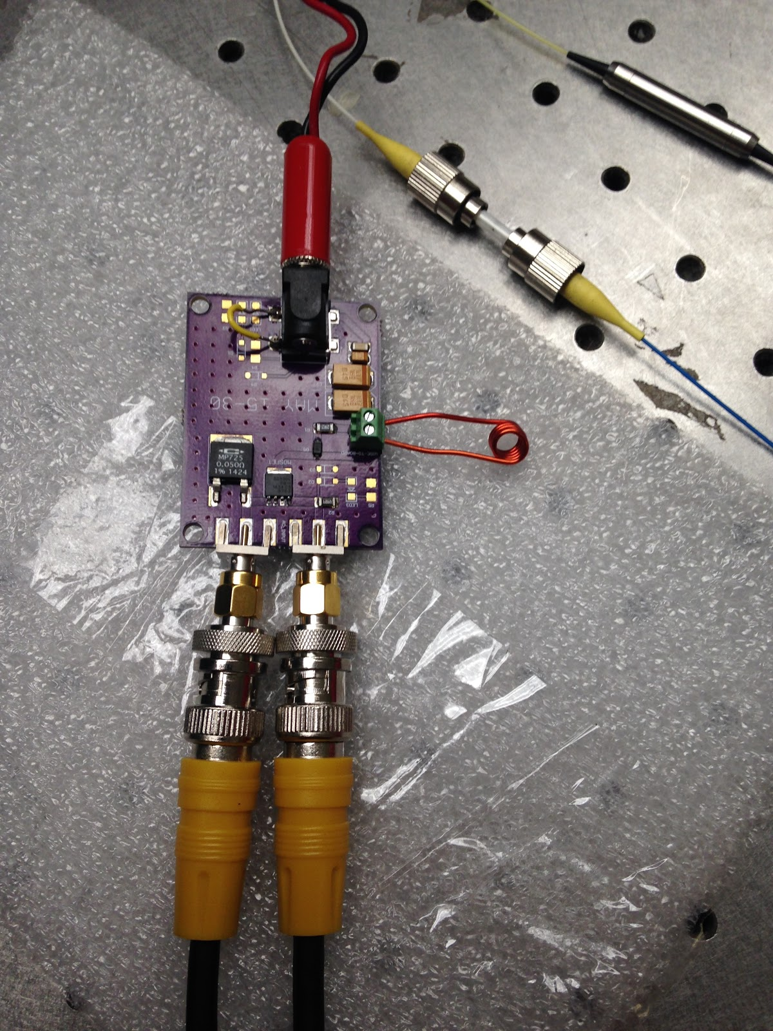
May15-30: Fast, Compact, High Strength Magnetic Pulse Generator

Slide 27
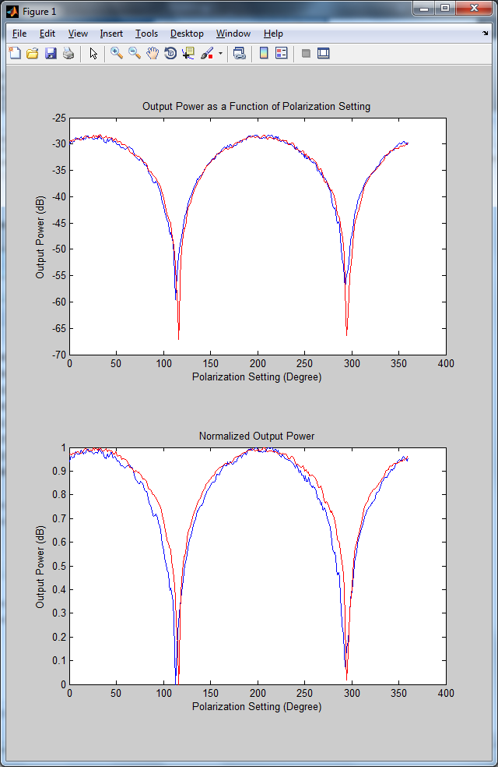
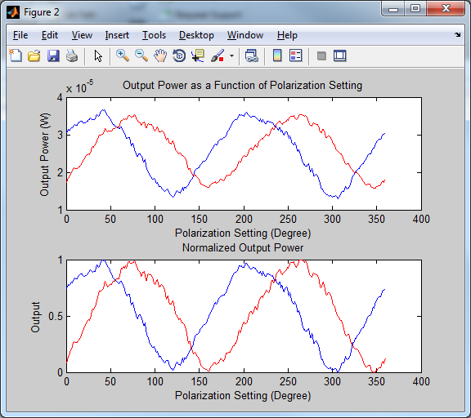
Test Results
Obtained Results
Expected Results
May15-30: Fast, Compact, High Strength Magnetic Pulse Generator
Notes:
Compare to theoretical results

Slide 28

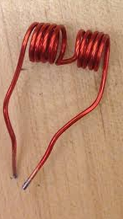

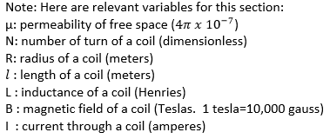

Coil Equations
Single Coil Calculations
Helmholtz Coil Calculations
May15-30: Fast, Compact, High Strength Magnetic Pulse Generator

Slide 29
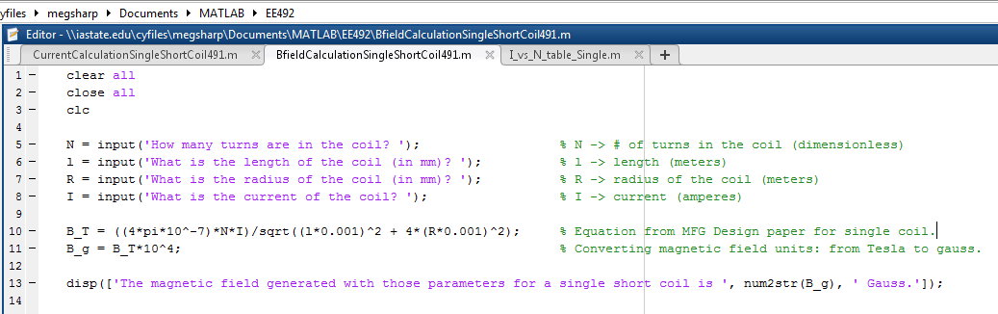
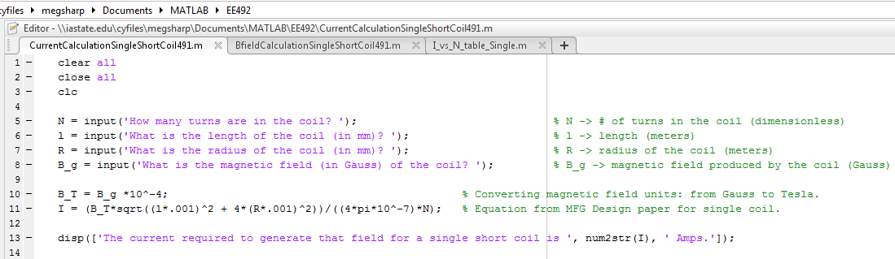
MATLAB CODE – Single Coil

Slide 30
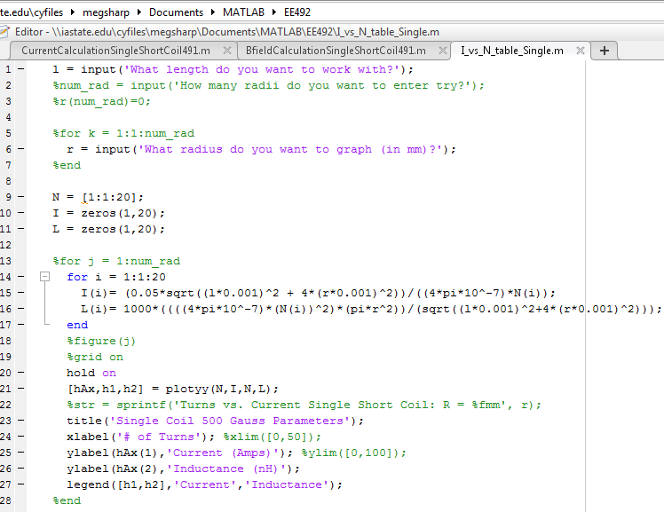
MATLAB CODE – Single Coil Continued…

Slide 31
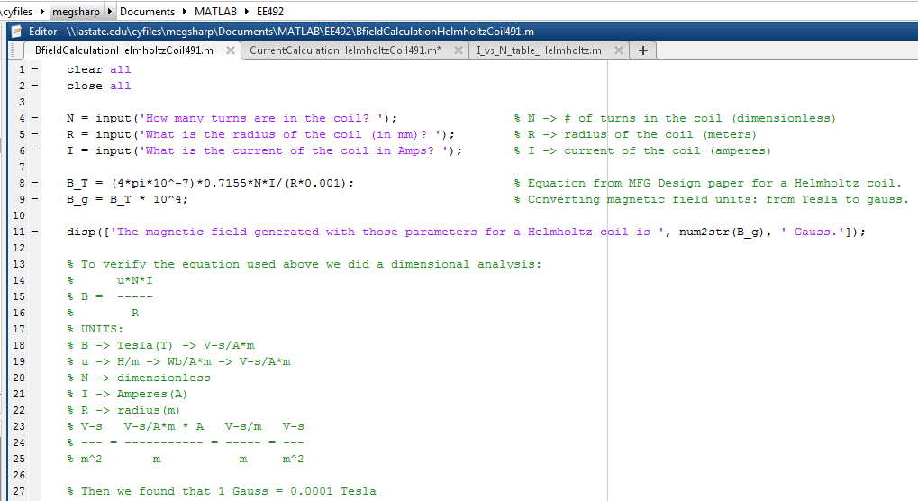
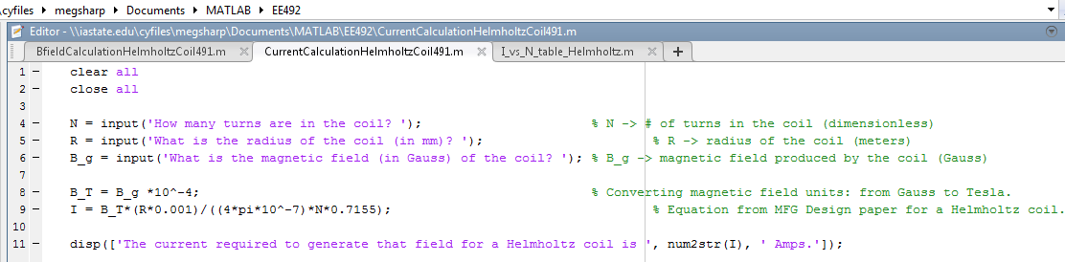
MATLAB CODE – Helmholtz Coil

Slide 32
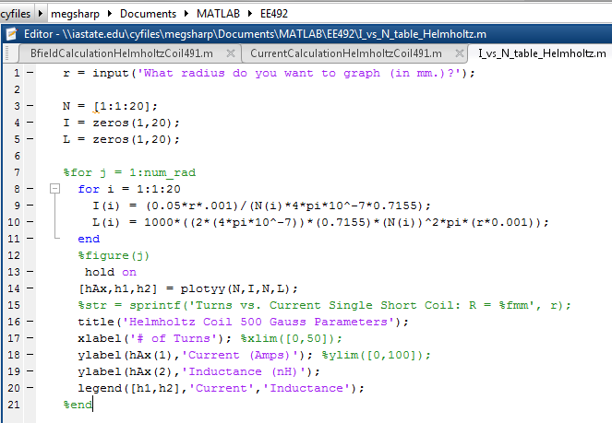
MATLAB CODE – Helmholtz Coil Cont…

Slide 33
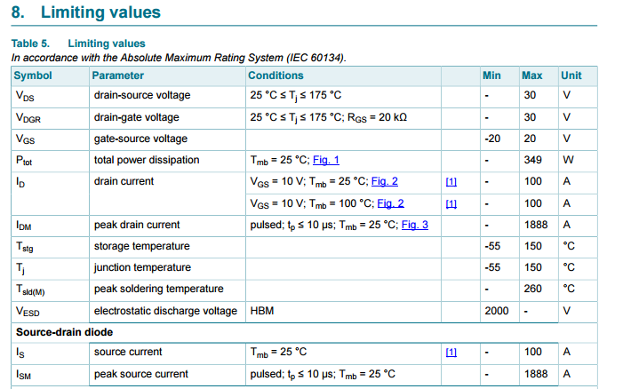
MOSFET
http://www.nxp.com/documents/data_sheet/PSMN0R9-30YLD.pdf

Slide 34

Current Sense Resistor
http://www.caddock.com/Online_catalog/Mrktg_Lit/MP725.pdf

Slide 35
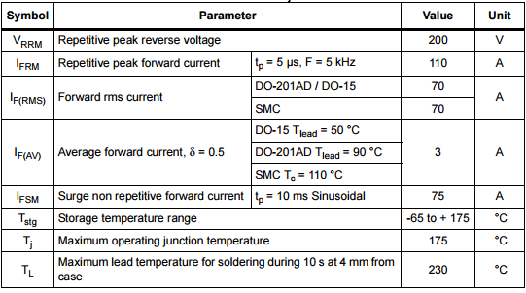
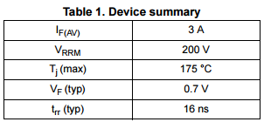
Diode
http://www.st.com/web/en/resource/technical/document/datasheet/CD00110333.pdf

