Slide 1
May15-30:
Fast, Compact, High Strength Magnetic Pulse Generator

Slide 2
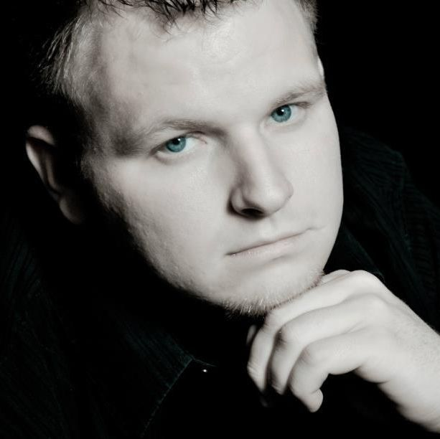




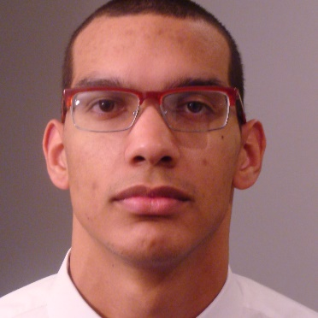

Team Members
Adam Kaas
Leader
Meiyong Himmtann
Webmaster
Greg Fontana
Simulator
Brandon Dixon
Layout Designer
Brittany Duffy
Communication Leader
Alain Ndoutoume
Systems Leader & Commissioner
Megan Sharp
Coil Designer
Advisors
Dr. Mani Mina, Senior Lecturer
John Pritchard, Graduate Student
Robert Bouda, Graduate Student
Client
Iowa State University High Speed Systems Engineering Lab

Slide 3
Presentation Outline
Problem Statement
Applications/Needs
Functional/Non-Functional Requirements
Basic Circuit Idea
Design Cycle
Detailed Design and Analysis
Testing Approach
Risk Assessment
Current Project Status
Future Project Plans

Slide 4
Problem Statement
Design a magnetic pulse generator that is:
  Fast (1µs)
  Compact (3.5” x2”)
  High Strength (500 G)

Slide 5
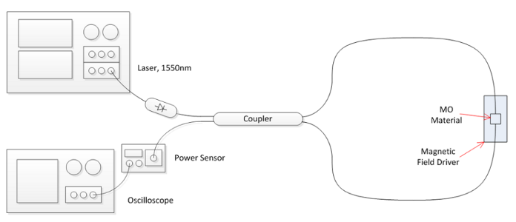
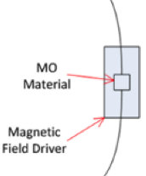
Applications/Needs
Fast-switching needs
Magneto-optics
    Magneto-Optic Interferometer
Sagnac Configuration Interferometer
Photo Courtesy of John W. Pritchard

Slide 6
Functional Requirements
Magnetic field with strength ≥ 500 gauss
Magnetic Field 1µs pulse
Consistent Results
Non-functional Requirements
Dimensions ≤ 3.5" x 2"
Enclosed Device
DC voltage source ≤ 15 volts

Slide 7
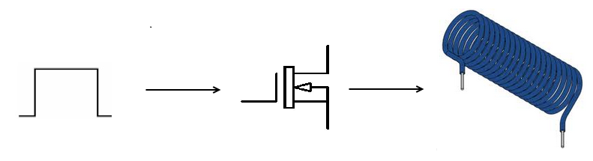
Basic Circuit Idea
Pulse to turn MOSFET on and off
Coil to generate magnetic field

Slide 8
Design Cycle
Consider Design Specs
  -Define coil team
  -Define MOSFET/ circuit team
Choose Coil
-Aim for low inductance
Test PCB
-Determine PCB meets all criteria
Choose MOSFET
-Handle design specs
-Handle current passing through coil
Solder Components onto PCB
Create PCB
-Use Protomat
Optimize Circuit
-Optimize circuit components around chosen MOSFET and coil
-Rearrange components
Create Layout
-Use EAGLE PCB
Simulate
-Aim for appropriate rise and fall times using OrCAD

Slide 9
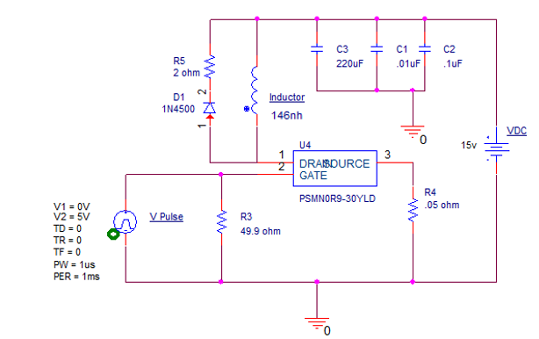
Detailed Design
Coil
MOSFET
Resistors
Capacitors
Diode

Slide 10
Coil
500 gauss
Inductance
Resistance
Notes:
Add picture

Slide 11
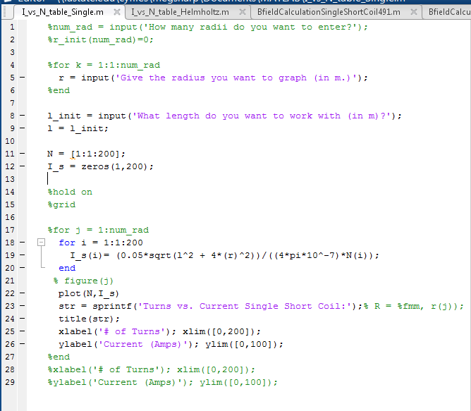
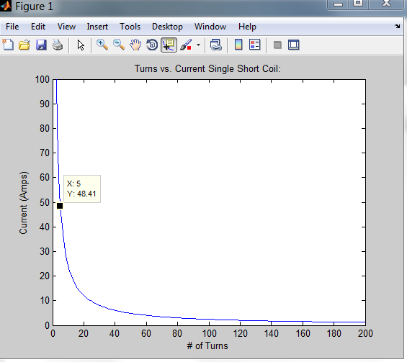
Preliminary Analysis
Calculate magnetic field
And Inductance
Turns vs current For 500 Gauss

Slide 12

MOSFET
“High Speed”
Continuous Drain Current (100A)
Large Max Drain-Source Voltage (50V)
Low Parasitic Inductance and Resistance

Slide 13
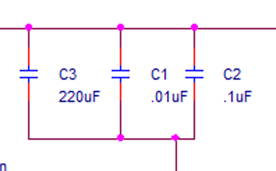
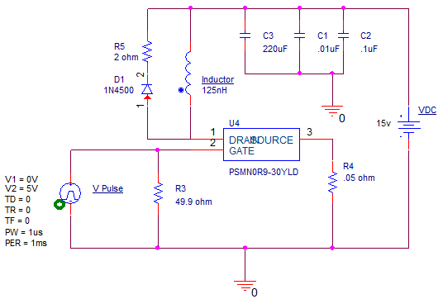
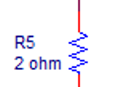
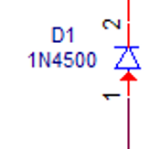
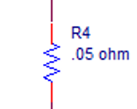
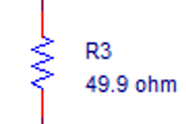
Resistors, Capacitors, and Diode
Three Resistors
  49.9Ω, 2Ω, 0.05Ω
Three Capacitors
  0.01uF, 0.1uF, 220uF
One Diode
  200 V reverse
  breakdown

Slide 14
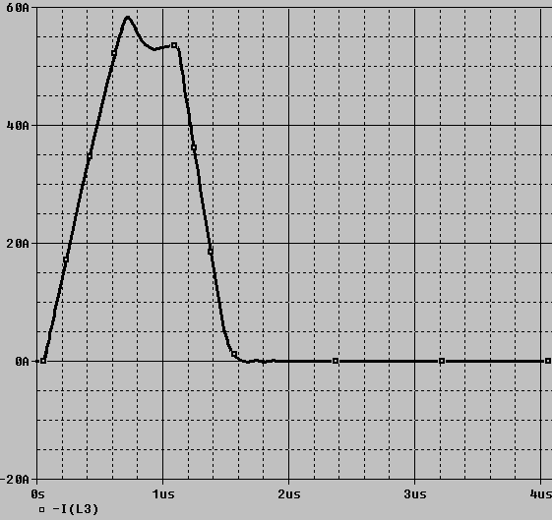
Simulations
Schematic
simulations

Slide 15
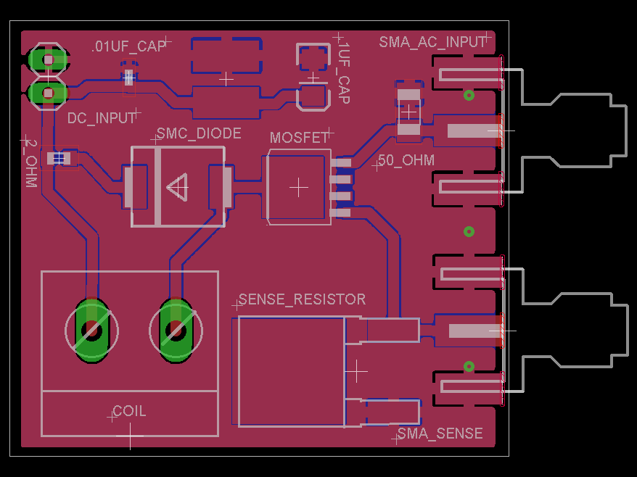
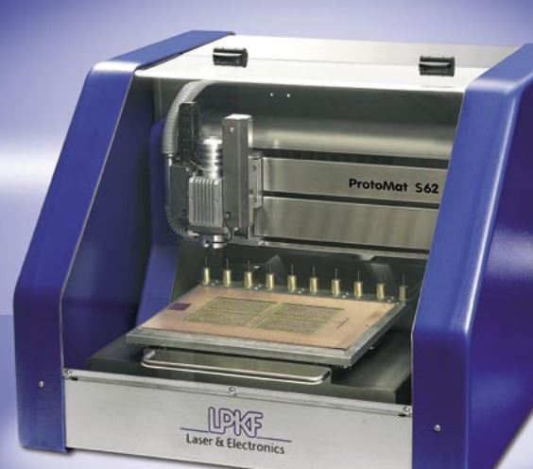
Eagle PCB/Protomat S62
Fabricate Board
layout
1.49 x 1.30 inches
Notes:
SMA used because our client uses SMA
Drain is mounting base on left
Gate is to 50 Ohm
Source is to sense resistor

Slide 16
Testing Approach
0.05Ω Current Sense Resistor
Magnetic Field Calculations
  Current
  Number of Turns
  Radius of Coil
  Length of Coil

Slide 17
Risk Assessment
Ordering enough parts early enough to compensate for additional prototyping
Physical Dangers:
  Risk of shock
  Risk of burning
Mitigation of risk:
  Following lab safety instructions

Slide 18
Current Project Status
Major Milestones:
  Working Proof of Concept due 12/19/14
    Parts received 12/3/14
  Website developed and up-to-date
Second Semester Short-Term Goals:
  New parts selected by February 3rd

Slide 19
Plan for Next Semester
Circuit testing
Helmholtz coil
Professionally fabricated PCB
Device enclosure

Slide 20
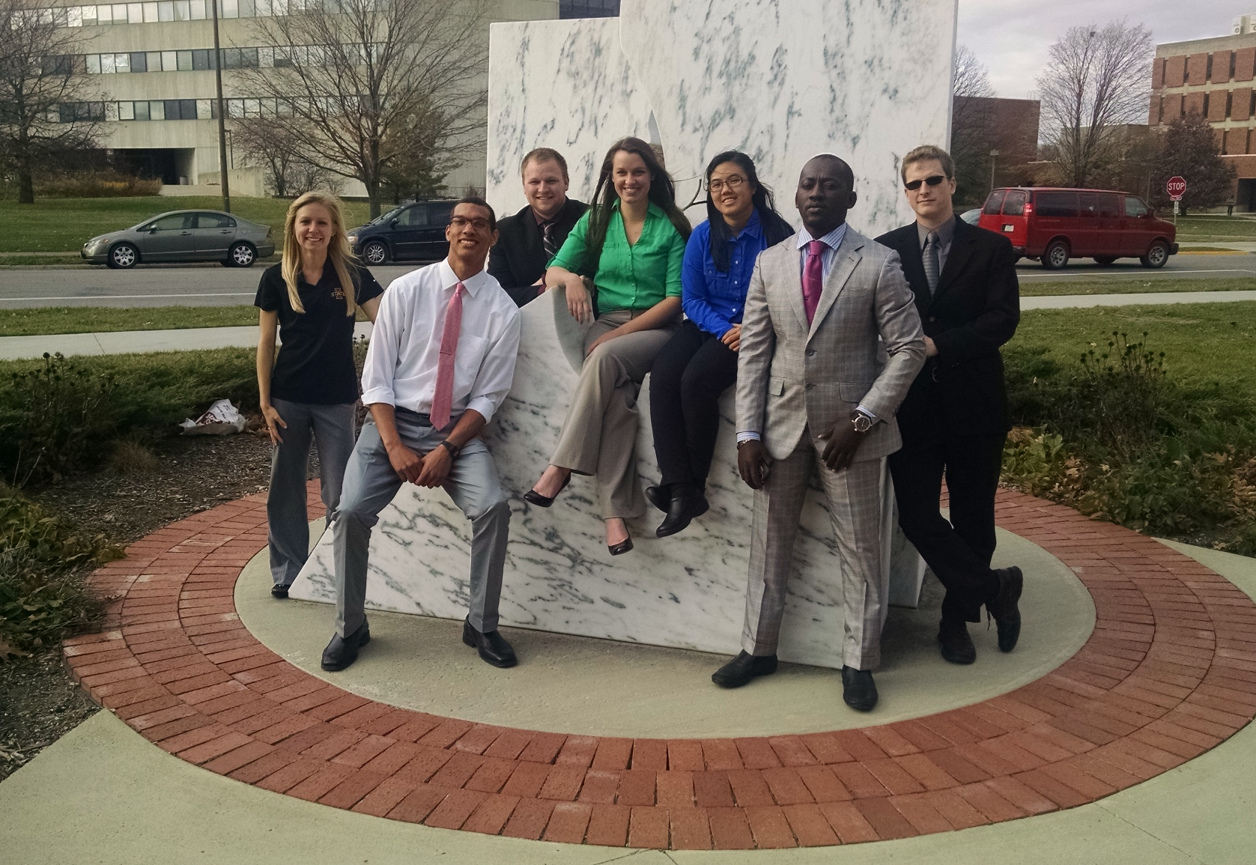
Questions?

Slide 21
Project Milestones & Schedule
Assessment of proposed solution: Big progress and better comprehension of what we are doing: (adding capacitors, sensing resistor, SMA connectors to our circuit and etc...)
Project Plan and Design Document due by end of first semester
Proof of Concept by 12/19/14
4/17/15, final paper complete and deliver final product
Notes:
Condense, add schedule

Slide 22
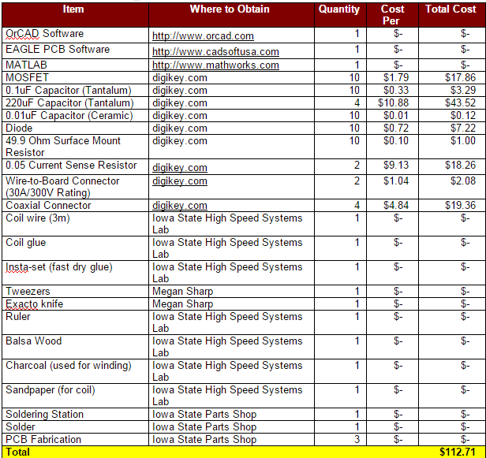
Resource/Cost Estimate- Prototype Hardware and Software

Slide 23
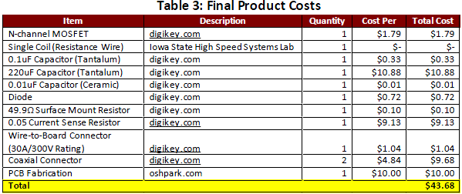
Resource/Cost Estimate– Final Product

Slide 24

Equations
  $\frac{Current∗Pulse Width}{Voltage}=Capacitance$
  $\frac{48.41\frac{Coulomb}{second}∗1∗{10}^{−6}seconds}{15 Volts}=3.227 uF$
  $L=\frac{µN^{2}(πR^{2})}{\sqrt{l^{2}+4R^{2}}}=\frac{(4π x {10}^{−7})5^{2}(π∗{(3 x {10}^{−3})}^{2})}{\sqrt{{({1 x 10}^{−3})}^{2}+4{(3 x {10}^{−3})}^{2}}}=146nH$
  $B=\frac{µNI}{\sqrt{l^{2}+4R^{2}}}=0.057865 Teslas=578.65 gauss$

Slide 26
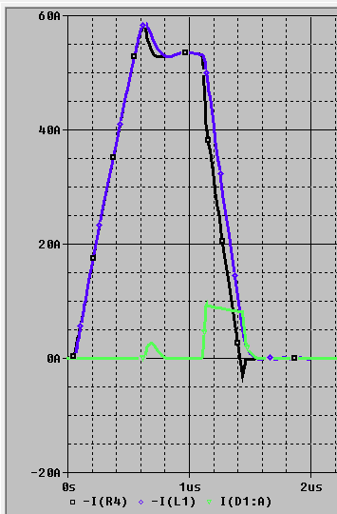
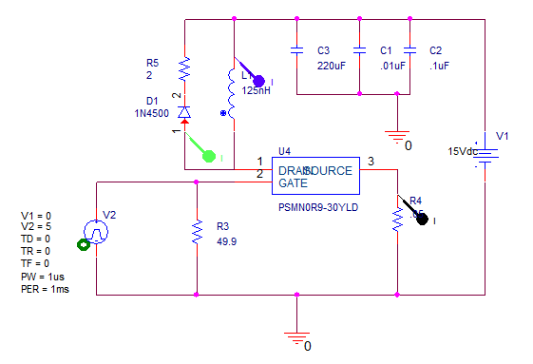
Currents

Slide 27
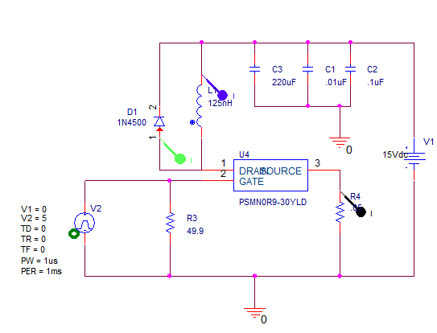
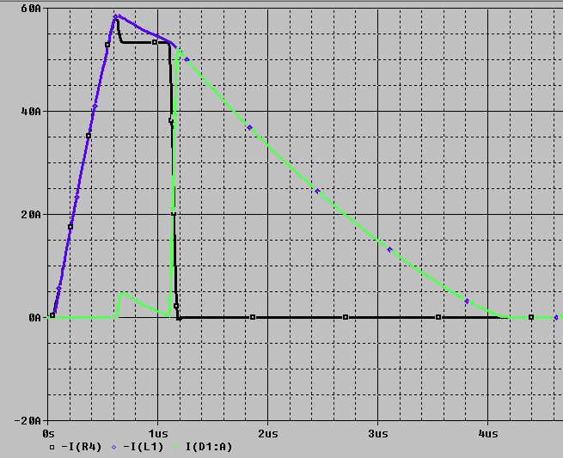
Without 2Ω Resistor

Slide 28
MOSFET Datasheet

